Slide 1
7. Functions and Modules
1.1–1.2
Notes:
(7.1a) Explain the meaning and use of static methodsin Java.
(7.1b) Use pre-existing functions/modules when writing program code.
(7.1c) Define and use static methods with and without parameters in program code.
(7.1d) Define and use static methods with and without return values in program code.
(7.1e) Define and use static methods that include arrays as parameters or return types.
(7.1f) Explain and illustrate the call stack for a program that includes multiple method calls.
(7.1g) Trace and write programs that include methods having multiple return statements.
(7.1h) Write program code that includes calls to Java Library methods. Can we decide which we will be using and list them?
(7.1i) Describe the meaning of each part of a method signature.
(7.1j) Identify the scope of variables in a program that includes multiple methods.
(7.1k) Explain the difference between local variables and parameter variables.
(7.1l) Explain the difference between a method implementation and a method call.
(7.1m) Trace and write programs involving overloaded methods.
(7.1n) Identify the scope of a variables in a program with multiple methods and method calls.

Slide 2
7. Functions and Modules
Basic concepts
Modular programming and libraries
Adopted and modified from Slides by Sedgewick and Wayne

Slide 3

Context: basic building blocks for programming
any program you might want to write
objects
functions and libraries
functions and libraries
This lecture:
Reuse code to build big programs from small pieces
graphics, sound, and image I/O
arrays
conditionals and loops
conditionals and loops
Math
text I/O
primitive data types
assignment statements

Slide 4
Functions, libraries, and modules
Modular programming
Organize programs as independent modules that do a job together.
Why? Easier to share and reuse code to build bigger programs.
Facts of life
Support of modular programming has been a holy grail for decades.
Ideas can conflict and get highly technical in the real world.
Def. A library is a set of functions.
Def. A module is a .java file.
for purposes of this lecture
for purposes of this course
For now. Libraries and modules are the same thing: .java files containing sets of functions.
Later. Modules implement data types (stay tuned).

Slide 5
Functions (static methods)
Explain the meaning and use of static methods in Java.
.
LO 7.1a
Java function ("aka static method")
Takes zero or more input arguments.
Returns zero or one output value.
May cause side effects (e.g., output to standard draw).
input x
Java functions are more general than mathematical functions
side
effects
Applications
Scientists use mathematical functions to calculate formulas.
Programmers use functions to build modular programs.
You use functions for both.
function f
output f(x)
Examples seen so far
Built-in functions: Math.random(), Math.abs(), Integer.parseInt().
Our I/O libraries: StdIn.readInt.
User-defined functions: main().
Notes:
(7.1a) Explain the meaning and use of static methodsin Java.

Slide 6
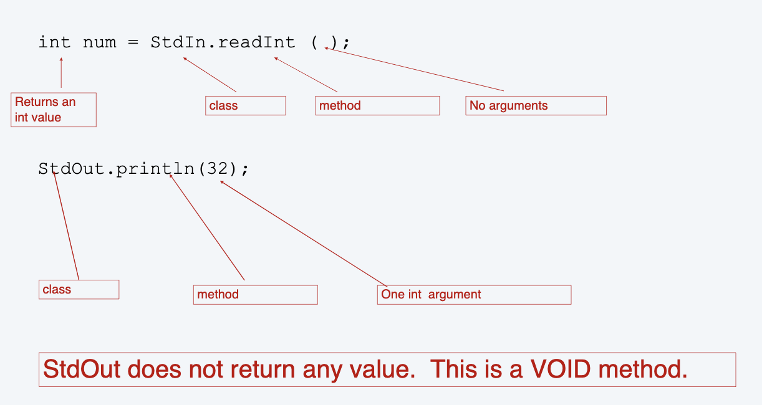
A look at method calls:

Slide 7
Methods—why?
A way to break a complex program into smaller pieces
A method consists of:
a set of operations for carrying out a certain task that can be called from different places in the program
name (how the method is known and called
parameters (information does the method needs to accomplish its task
return value (result computed by the subroutine)
In Java every method must be declared inside a some class.
That is the reason we always create a class to write our main method.
Static and non-static subroutines
static: belongs to the class
non-static: belong to the object (we’ll learn later)

Slide 8
Anatomy of a Java static method
<modifiers> <return-type> <name> (<parameters>){
<statements>
}
public static int factorial(int n){}
public static int pow(int base, int exponent){}
Let’s Code!

Slide 9
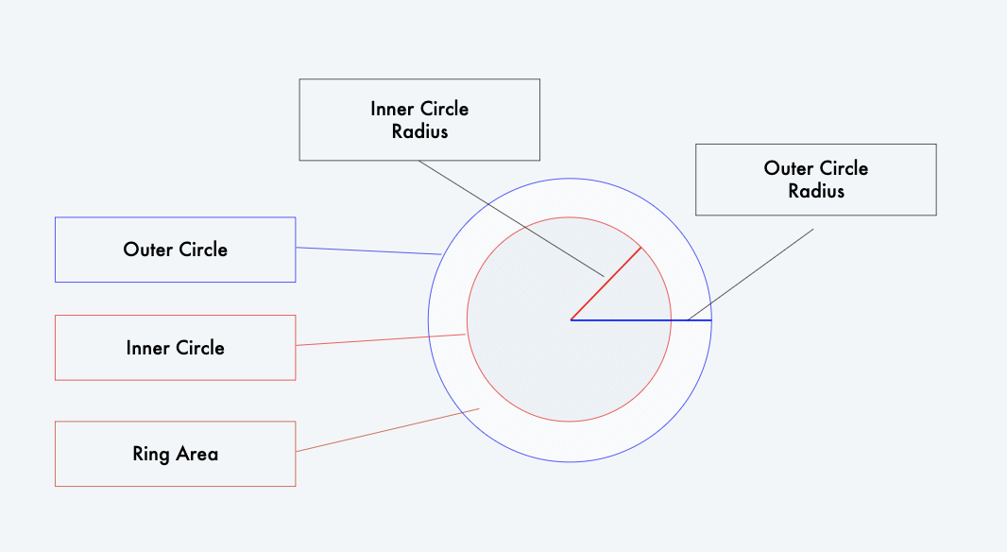
Example: Ring Area

Slide 10
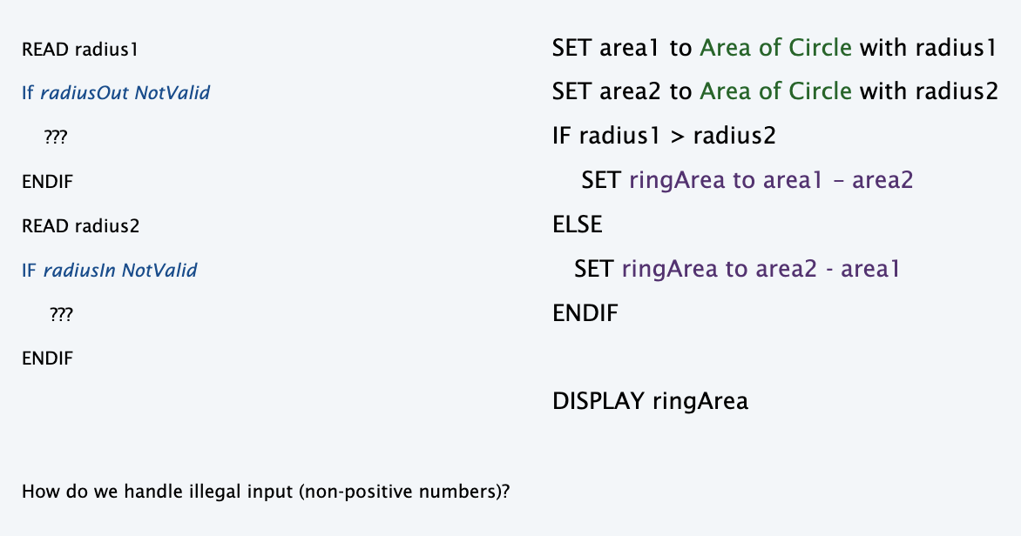
Example: Ring Area - Pseudocode

Slide 11
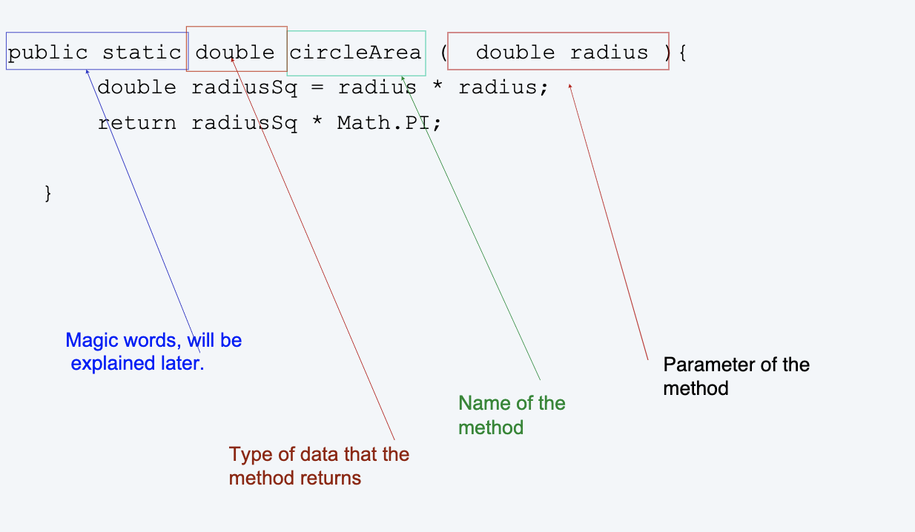
Example: Ring Area – Implementing in Java

Slide 12
Static methods with array parameters
Define and use static methods that include arrays as parameters or return types.
LO 7.1e
public class Sum
{
public static double sum(double[ ] a)
{
double sum = 0;
for (int i=0; i < a.length; i++)
sum += a[i];
return sum;
}
public static void main(String[] args)
{
double[] a = new double[args.length];
for (int i = 0; i < args.length; i++)
a[i] = Double.parseDouble(args[i]);
for (int i = 0; i < a.length; i++)
StdOut.println(sum(a));
}
}
Key point. Static methods can receive array parameters
library/module name
sum() method
module named
Sum.java
main() method
Notes:
(7.1e) Define and use static methods that include arrays as parameters or return types.

Slide 13
Static methods with array return type
Define and use static methods that include arrays as parameters or return types.
LO 7.1e
public class Create
{
public static double create(int n)
{
double[] a = new double[n];
for (int i=0; i < a.length; i++)
a[i] = i;
return a;
}
public static void main(String[] args)
{
int n = Integer.parseInteger(args[0]);
double[ ] a = create(n);
for (int i = 0; i < a.length; i++)
StdOut.println(a[i]);
}
}
library/module name
Key point. Static methods can return an array
create() method
module named
Create.java
z
main() method
Notes:
(7.1e) Define and use static methods that include arrays as parameters or return types.

Slide 14
Pop quiz 1a on functions
Q. What happens when you compile and run the following code?
public class PQfunctions1a
{
public static int cube(int i)
{
int j = i * i * i;
return j;
}
public static void main(String[] args)
{
int N = Integer.parseInt(args[0]);
for (int i = 1; i <= N; i++)
StdOut.println(i + " " + cube(i));
}
}

Slide 15
Pop quiz 1a on functions
Q. What happens when you compile and run the following code?
public class PQfunctions1a
{
public static int cube(int i)
{
int j = i * i * i;
return j;
}
public static void main(String[] args)
{
int N = Integer.parseInt(args[0]);
for (int i = 1; i <= N; i++)
StdOut.println(i + " " + cube(i));
}
}
A. Takes N from the command line, then prints cubes of integers from 1 to N
% javac PQfunctions1a.java
% java PQfunctions1a 6
1 1
2 8
3 27
4 64
5 125
6 216

Slide 16
Pop quiz 1b on functions
Q. What happens when you compile and run the following code?
public class PQfunctions1b
{
public static int cube(int i)
{
int i = i * i * i;
return i;
}
public static void main(String[] args)
{
int N = Integer.parseInt(args[0]);
for (int i = 1; i <= N; i++)
StdOut.println(i + " " + cube(i));
}
}

Slide 17
Pop quiz 1b on functions
Q. What happens when you compile and run the following code?
public class PQfunctions1b
{
public static int cube( int i )
{
int i = i * i * i;
return i;
}
public static void main(String[] args)
{
int N = Integer.parseInt(args[0]);
for (int i = 1; i <= N; i++)
StdOut.println(i + " " + cube(i));
}
}
A. Won't compile. Argument variable i is declared and initialized for function block, so the name cannot be reused.
% javac PQfunctions1b.java
PQfunctions1b.java:5: i is already defined in cube(int)
int i = i * i * i;
^
1 error

Slide 18
Pop quiz 1c on functions
Q. What happens when you compile and run the following code?
public class PQfunctions1c
{
public static int cube(int i)
{
i = i * i * i;
}
public static void main(String[] args)
{
int N = Integer.parseInt(args[0]);
for (int i = 1; i <= N; i++)
StdOut.println(i + " " + cube(i));
}
}

Slide 19
Pop quiz 1c on functions
Q. What happens when you compile and run the following code?
public class PQ6_1c
{
public static int cube(int i)
{
i = i * i * i;
}
public static void main(String[] args)
{
int N = Integer.parseInt(args[0]);
for (int i = 1; i <= N; i++)
StdOut.println(i + " " + cube(i));
}
}
A. Won't compile. Need return statement.
% javac PQfunctions1c.java
PQfunctions1c.java:6: missing return statement
}
^
1 error

Slide 20
Pop quiz 1d on functions
Q. What happens when you compile and run the following code?
public class PQfunctions1d
{
public static int cube(int i)
{
i = i * i * i;
return i;
}
public static void main(String[] args)
{
int N = Integer.parseInt(args[0]);
for (int i = 1; i <= N; i++)
StdOut.println(i + " " + cube(i));
}
}

Slide 21
Pop quiz 1d on functions
Q. What happens when you compile and run the following code?
A. Works. The i in cube() is
Declared and initialized as an argument.
Different from the i in main().
BUT changing values of function arguments is sufficiently confusing to be deemed bad style for this course.
public class PQfunctions1d
{
public static int cube(int i)
{
i = i * i * i;
return i;
}
public static void main(String[] args)
{
int N = Integer.parseInt(args[0]);
for (int i = 1; i <= N; i++)
StdOut.println(i + " " + cube(i));
}
}
% javac PQfunctions1d.java
% java PQfunctions1d 6
1 1
2 8
3 27
4 64
5 125
6 216

Slide 22
Pop quiz 1e on functions
Q. What happens when you compile and run the following code?
public class PQfunctions1e
{
public static int cube(int i)
{
return i * i * i;
}
public static void main(String[] args)
{
int N = Integer.parseInt(args[0]);
for (int i = 1; i <= N; i++)
StdOut.println(i + " " + cube(i));
}
}

Slide 23
Pop quiz 1e on functions
Q. What happens when you compile and run the following code?
public class PQfunctions1e
{
public static int cube(int i)
{
return i * i * i;
}
public static void main(String[] args)
{
int N = Integer.parseInt(args[0]);
for (int i = 1; i <= N; i++)
StdOut.println(i + " " + cube(i));
}
}
A. Works fine. Preferred (compact) code.
% javac PQfunctions1e.java
% java PQfunctions1e 6
1 1
2 8
3 27
4 64
5 125
6 216

Slide 24
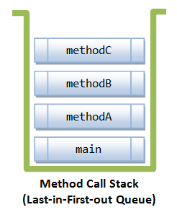
Function call stack
Explain and illustrate the call stack for a program that includes multiple method calls.
LO 7.1f
Q. What happens when you call a function?
public class Demo
{
public static int methodA() {
methodB(); // calls method B
}
public static int methodB() {
methodC(); // calls method C
}
public static int methodC() {
…
}
public static void main(String[] args){
methodA(); // call methodA
}
}
A. A function call stack is created. A call stack contains information about function variables and other system information. In the above case, methodA call from main result in series of function calls.
Notes:
(7.1f) Explain and illustrate the call stack for a program that includes multiple method calls.

Slide 25
Tracing a function call stack
Trace and write programs that include methods having multiple return statements.
.
LO 7.1g
Q. What is the output of the following code?
public class Demo2
{
public static int add(int a, int b) { return a+b; }
public static int multiply(int a, int b) { return a*b; }
public static int square(int a) { return a*a; }
public static void main(String[] args)
{
int x = 3, y = 4;
int z = add(multiply(square(x), y), add(x, square(y));
}
}
A. This returns the value 55 (explain)
Notes:
(7.1g) Trace and write programs that include methods having multiple return statements.

Slide 26
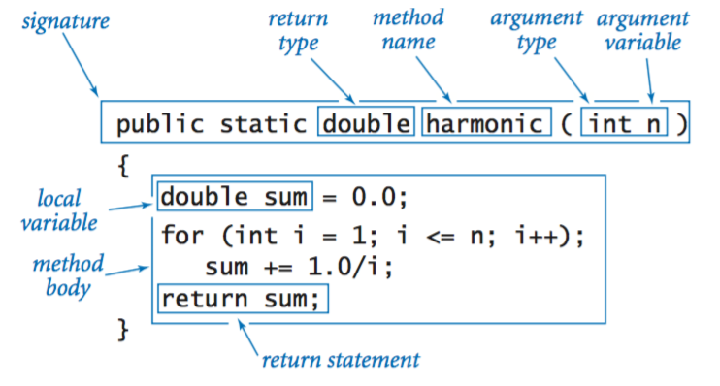
Understanding the method signature
Describe the meaning of each part of a method signature.
.
LO 7.1i
A method signature defines the form of the method.
Static methods allow method to be called without an object (We will study objects later).
For the purpose of this course, the method signature only includes the method name and arguments
This Photo by Unknown Author is licensed under CC BY-SA-NC
Notes:
(7.1i) Describe the meaning of each part of a method signature.

Slide 27
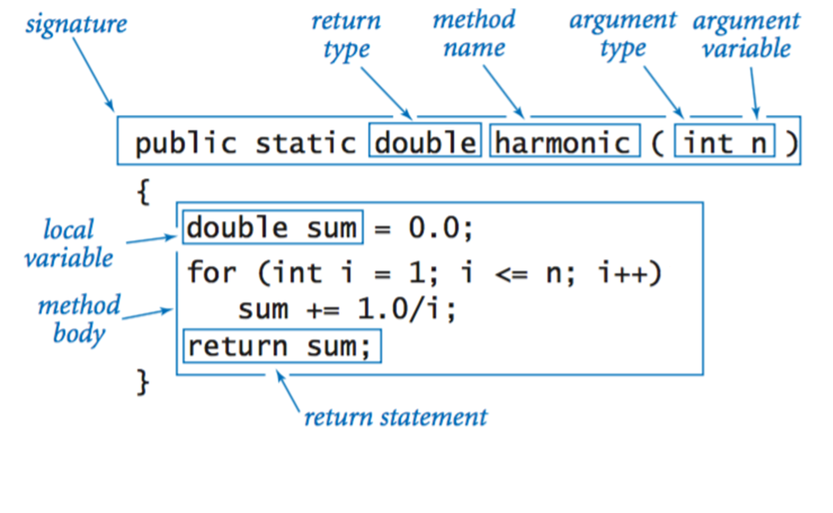
Method local variables and parameter variables
Explain the difference between local variables and parameter variables.
.
LO 7.1k
The scope of a variable depends on how it is defined.
n is a parameter variable The scope of n is the entire function body
sum is a local variable The scope of sum is also the entire function body
Loop control i is a local variable whose scope is the loop body
For the purpose of this course, the method signature only includes the method name and arguments
This Photo by Unknown Author is licensed under CC BY-SA-NC
Notes:
(7.1k) Explain the difference between local variables and parameter variables.

Slide 28
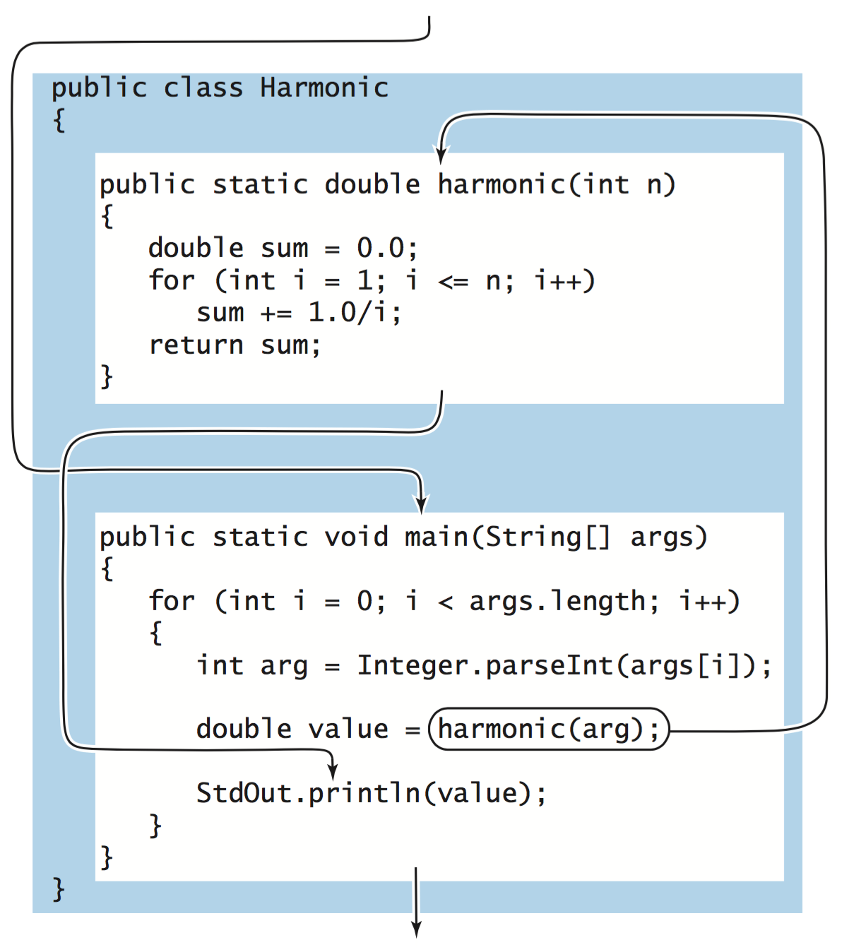
Method implementation and method call
Explain the difference between a method implementation and a method call.
.
LO 7.1l
The method implementation is how the method is defined.
The method call is how the method is used.
Notes:
(7.1l) Explain the difference between a method implementation and a method call.

Slide 29
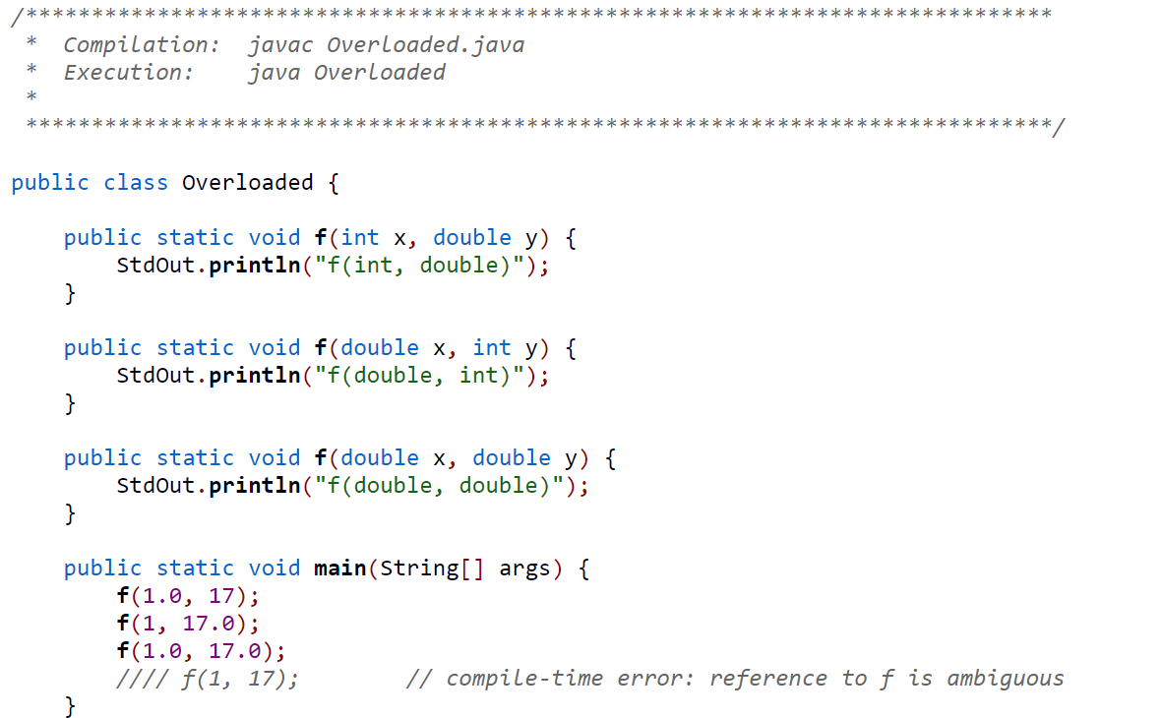
Overloaded methods
Trace and write programs involving overloaded methods.
LO 7.1m
Same method name f, but different argument types.
Compiler will decide which method to use based on argument type
Source: introcs.cs.princeton.edu
Notes:
(7.1m) Trace and write programs involving overloaded methods.

Slide 30
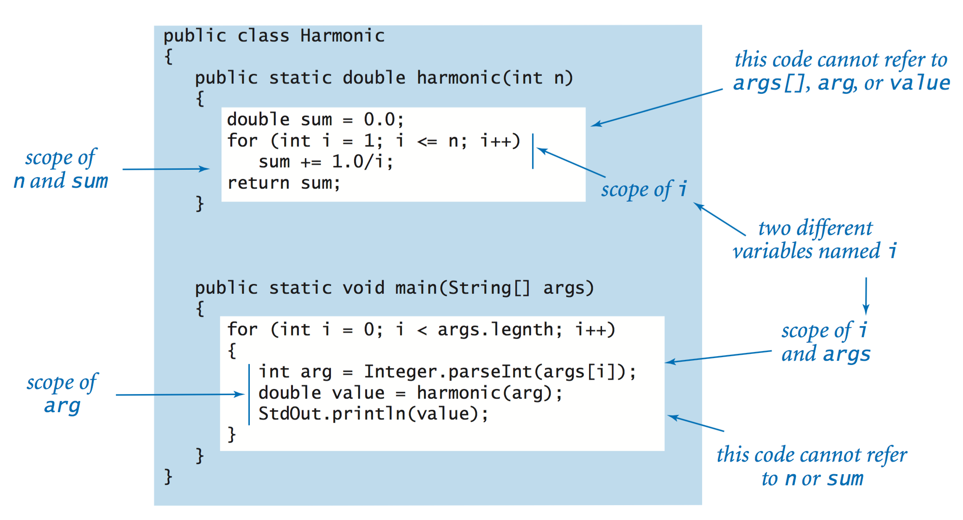
Scope of a variable
Identify the scope of a variables in a program with multiple methods and method calls.
LO 7.1n
Notes:
(7.1n) Identify the scope of a variables in a program with multiple methods and method calls.

Slide 31
7. Functions and Modules
Basic concepts
Modular programming

Slide 32
Fundamental abstractions for modular programming
Client
API
Implementation
Client
Module that calls a library's methods.
Applications programming interface (API)
Defines signatures, describes methods.
Implementation
Module containing library's Java code.
public class Gaussian
{
public static double pdf(double x)
{
double val = Math.exp(-x*x / 2);
val /= Math.sqrt(2 * Math.PI);
return val
}
...
}
public class Gaussian
double pdf(double x) | Gaussian probability density function
double cdf(double x) | Gaussian cumulative distribution function
public class GaussianPlot
{
...
y[i] = Gaussian.pdf(x[i]);
...
}

Slide 33
Why modular programming?
Modular programming enables
Independent development of small programs.
Every programmer to develop and share layers of abstraction.
Self-documenting code.
Fundamental characteristics
Separation of client from implementation benefits all future clients.
Contract between implementation and clients (API) benefits all past clients.
Challenges
How to break task into independent modules?
How to specify API?
Client
API
Implementation

Slide 34
Example: Java API - the Math Class
https://docs.oracle.com/javase/8/docs/api/java/lang/Math.html

Slide 35
Image sources
http://upload.wikimedia.org/wikipedia/commons/b/ba/Working_Together_Teamwork_Puzzle_Concept.jpg
http://pixabay.com/en/ball-puzzle-pieces-of-the-puzzle-72374/
http://upload.wikimedia.org/wikipedia/commons/e/ef/Ben_Jigsaw_Puzzle_Puzzle_Puzzle.png
http://en.wikipedia.org/wiki/Function_(mathematics)#mediaviewer/File:Function_machine2.svg
Image sources
http://xkcd.com/221/
http://upload.wikimedia.org/wikipedia/commons/b/ba/Working_Together_Teamwork_Puzzle_Concept.jpg
http://upload.wikimedia.org/wikipedia/commons/e/ef/Ben_Jigsaw_Puzzle_Puzzle_Puzzle.png
Image sources
http://commons.wikimedia.org/wiki/File:1405_Sound_Waves_and_the_Ear.jpg
http://en.wikipedia.org/wiki/The_Entertainer_(rag)#mediaviewer/File:EntertainerJoplinCover.JPEG
http://cantorion.org/music/497/The-Entertainer-Original-version

Slide 36
Image sources
http://www.intechopen.com/books/rheology-new-concepts-applications-and-methods/ a-practical-review-of-microrheological-techniques
http://tweezpal.natan.si
http://www.albartlett.org/articles/art2000jan.html
http://laser.physics.sunysb.edu/~vwang/beam-propagation/
http://www.nature.com/neuro/journal/v14/n12/full/nn.2958.html
http://www-cdf.fnal.gov/physics/new/top/2012/WHel9ifb/
http://en.wikipedia.org/wiki/Deutsche_Mark#mediaviewer/File:DEU-10m-anv.jpg

Slide 37
7. Functions and Modules
Basic concepts
Modular programming and libraries

Slide 38
7. Functions and Modules
1.1–1.2

